Slide 1

Chain Forward Risk Optimization: From Prototype to Production (V3.0)
A Quantitative Approach to MSME Credit Risk and Value Chain Viability
Prepared by Henry C. Dibie
Date: November 2025
Agenda:
Financial Viability (Q1)
Model Evolution (V1.0 → V3.0)
Strategic Recommendations (Q2–Q4)
Systemic Risk Framework

Slide 2
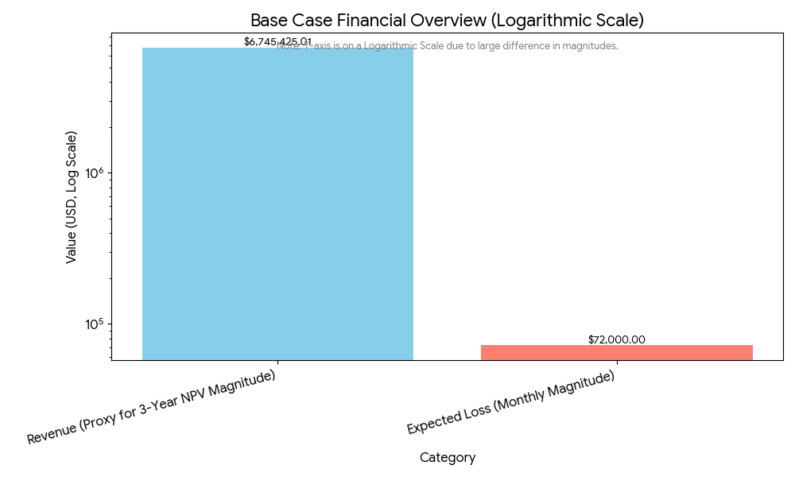
Is Chain Forward Financially Viable? The Critical Loss Scenario
Base Case NPV (3 Years): –$6,745,425.01
Monthly Net Loss: –$72,000.00
Break-Even Default Rate: 3.75%
The product is NOT viable under current projections. Viability depends entirely on active risk management to control defaults.

Slide 3
Problem-Solving: The Iteration that Unlocked Predictive Power
V1.0 Prototype | V3.0 Production Candidate
AUC ≈ 0.60 | AUC = 0.8820
Poor segmentation | Clear High-Risk separation
Target variable misdefined | Target re-engineered correctly
Scaling issues | Standardized + validated pipeline
I fixed the foundational data integrity issue, moving from a coin-toss prediction to a highly reliable risk assessment

Slide 4
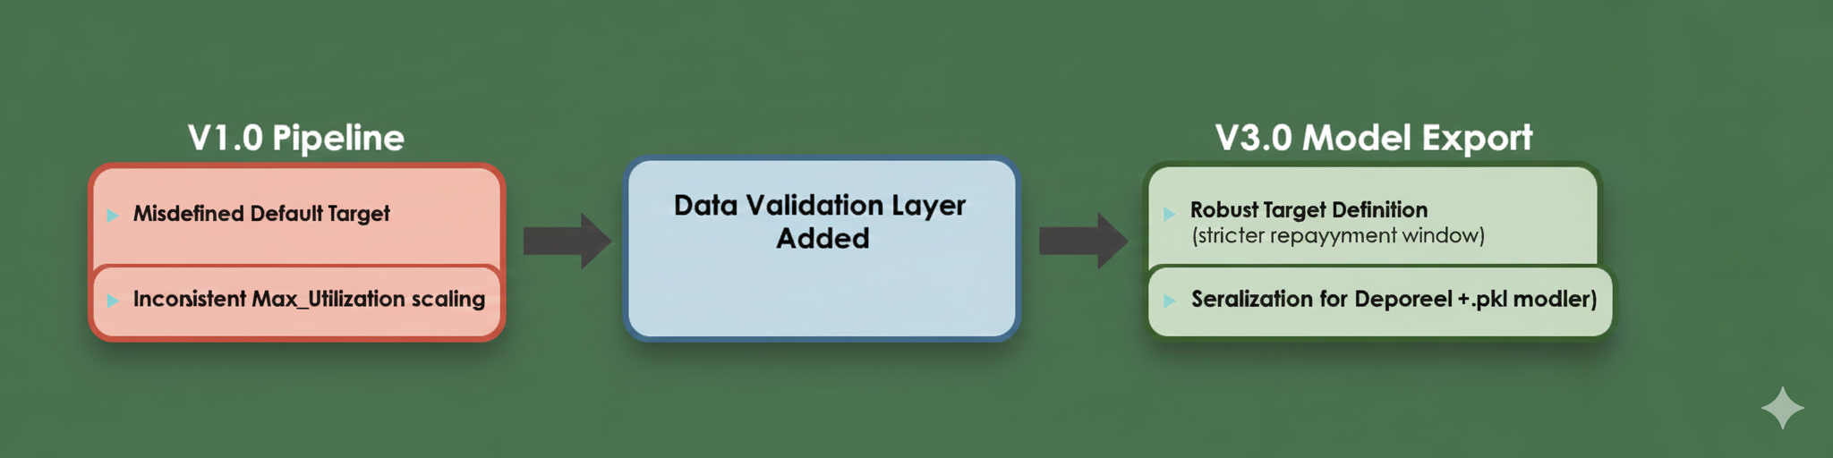
V3.0 Engineering Fix: Refined Target and Scaling
V1.0 Problems:
Misdefined Default Target
Inconsistent Max_Utilization scaling
V3.0 Solutions:
Robust Target Definition (stricter repayment window)
Data Validation Layer (normalization + leakage prevention)
Serialization for Deployment (.pkl model + scaler)

Slide 5
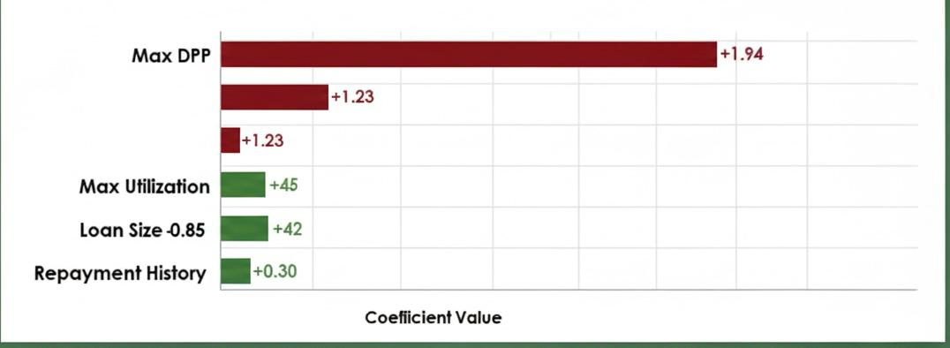
Key Risk Drivers: What Predicts MSME Default?
Feature Importance
Hypothesis: Does Alternative data dominate?
Conclusion: No — Traditional credit metrics lead.
EWIs (list):
Max DPD (Coeff +1.94)
Max Utilization (Coeff +1.23)

Slide 6
K-Means Segmentation: Targeting Risk for Policy
Segment | Risk Level | Key Behavior | Recommendation
1 | Low | Stable DPD, stable cashflow | Grow
2 | Moderate | Mid DPD, partner risk | Premium Pricing
0 | High | 22 DPD, 86.1% default | Decline
Recommend a Behavioral Clustering Approach to link credit metrics (DPD) with alternative data features (Cashflow Volatility) for tailored risk policy.

Slide 7
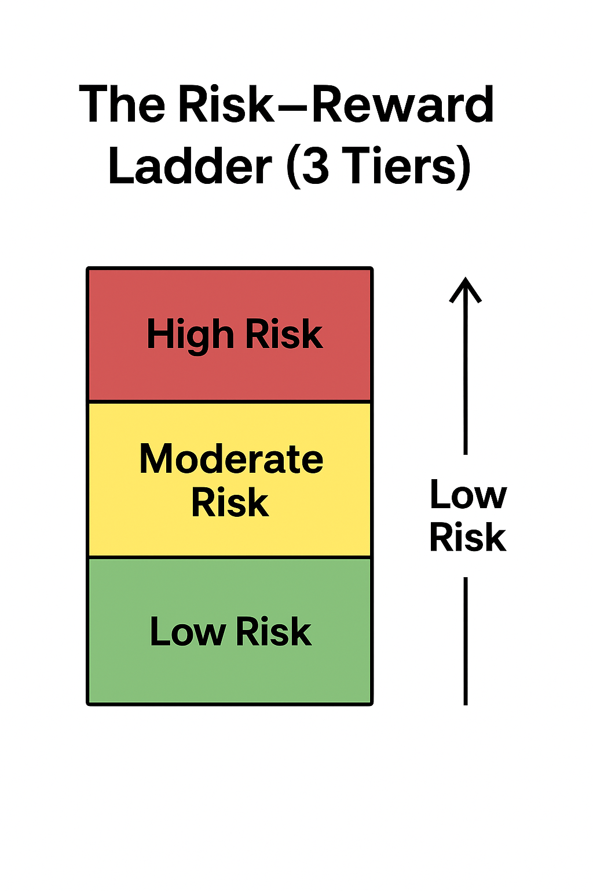
The Path to Profitability: Dynamic Risk-Based Pricing
Risk-Adjusted Return on Capital (RAROC) / Expected Loss Pricing
The interest rate must fully cover Expected Loss = PD × Exposure
Interest must also fund operational costs + required profit margin
Pricing is now model-driven, not guesswork
We are no longer pricing based on gut feeling; we are pricing based on the model’s precise PD score.

Slide 8
Modeling Interconnected Risk: Value Chain Cascades
The Challenge
Traditional credit models only predict individual borrower default
But MSMEs are interconnected through supply chains
If a critical buyer collapses, upstream suppliers will default even if they were previously healthy
This is Concentration Risk.

Slide 9
Model Governance: Ensuring Continuous Viability
Portfolio Health
Monitor Default Rate vs 3.75% threshold (weekly)
Model Performance
Watch for coefficient drift
Retrain if AUC drops below 0.85

Slide 10
Conclusion: Profitability Requires Segmentation
Recap:
V3.0 is validated & deployable (AUC 0.8820).
Hard Cut-Off needed for Segment 0.
Implement risk-based pricing.
Call to Action:
Deploy Segment 0 decline filters
Begin Graph Database for systemic risk

Slide 11
Thank you — Questions?

